Slide 1


Electric Circuits
Twelfth Edition, Global Edition
Chapter 4 – Part 5
Techniques of Circuit Analysis
© 2024 Pearson Education Ltd. All Rights Reserved.
Notes:
If this PowerPoint presentation contains mathematical equations, you may need to check that your computer has the following installed:
1) Math Type Plugin
2) Math Player (free versions available)
3) NVDA Reader (free versions available)

Slide 2
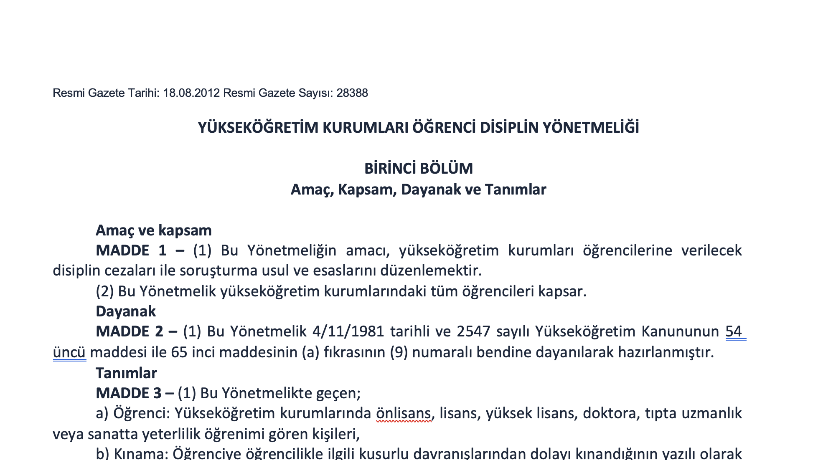
Student discipline regulations of higher education institutions
Notes:
If this PowerPoint presentation contains mathematical equations, you may need to check that your computer has the following installed:
1) Math Type Plugin
2) Math Player (free versions available)
3) NVDA Reader (free versions available)

Slide 3
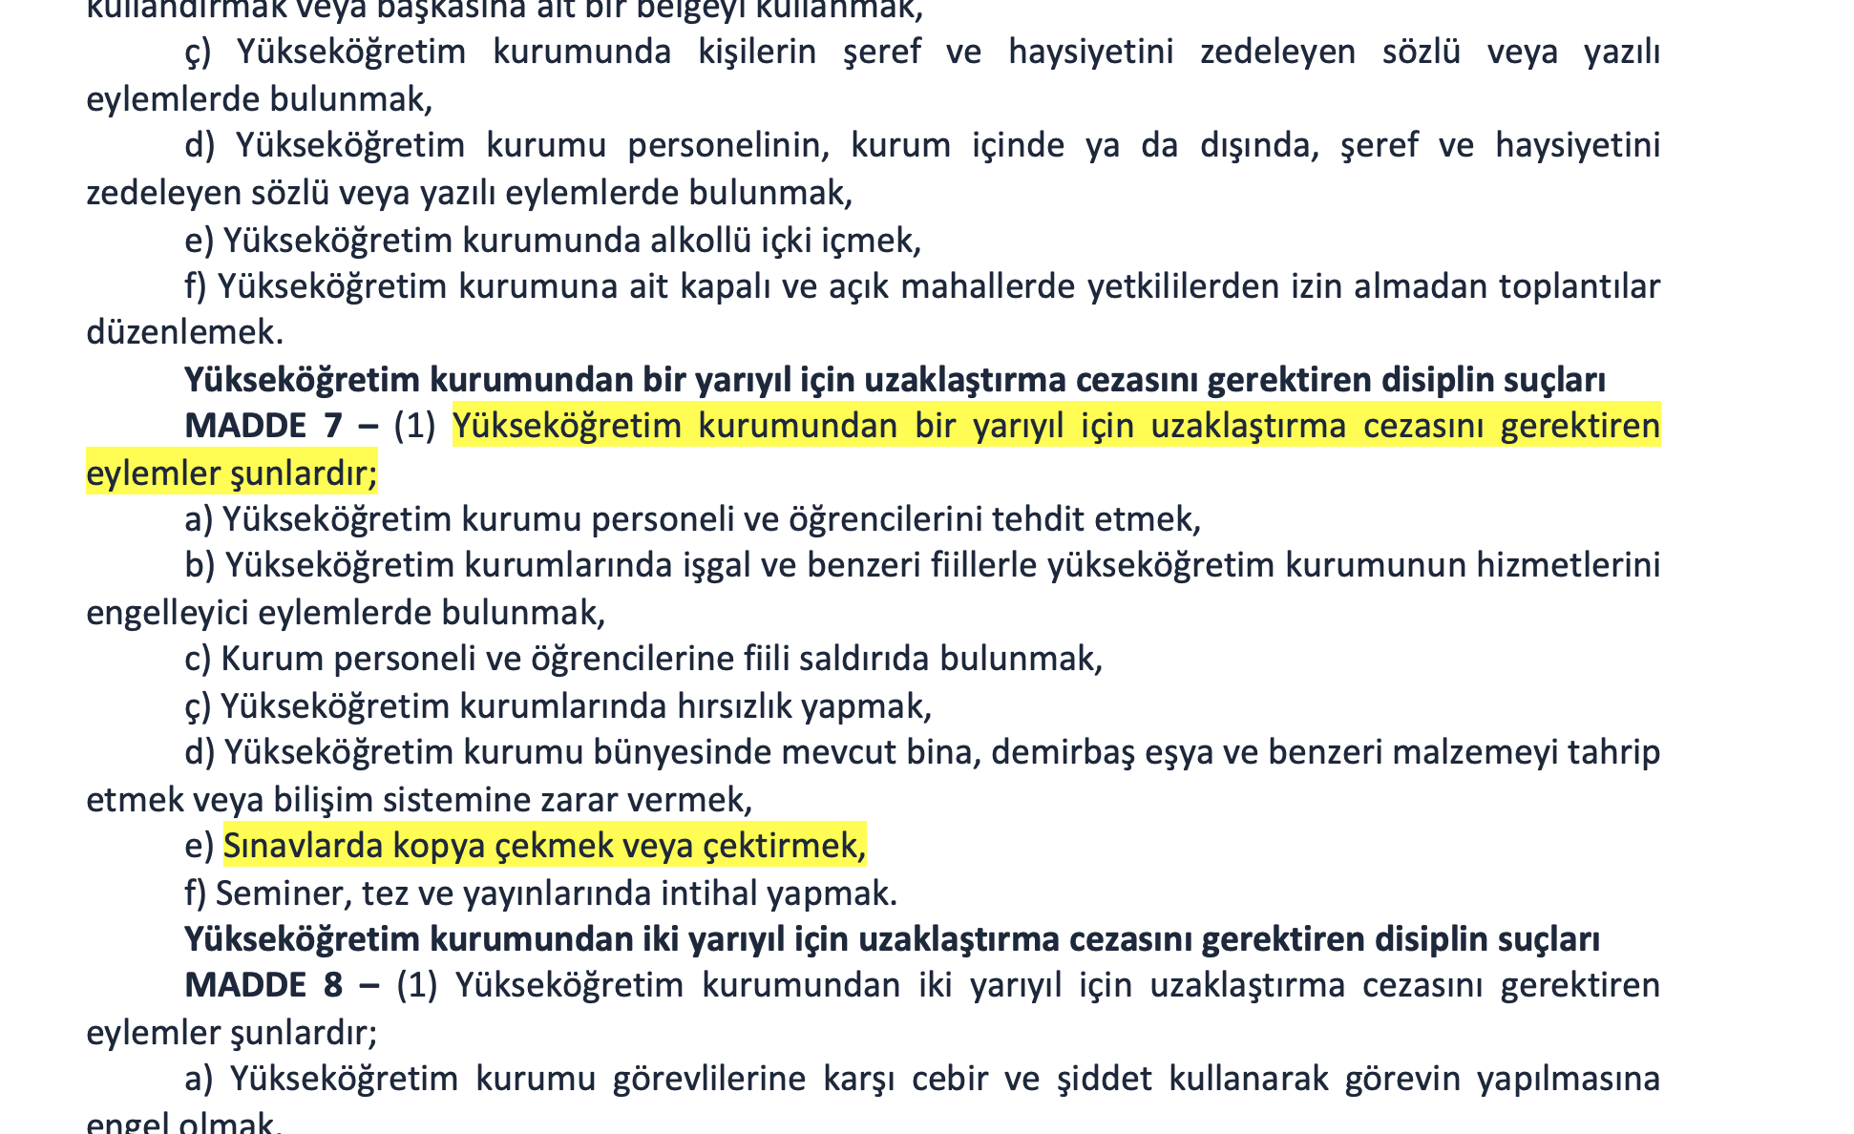
ARTICLE 7 – (1) Actions that require suspension from the higher education institution for one semester are as follows;
e) Cheating or having others cheat in exams,
Notes:
If this PowerPoint presentation contains mathematical equations, you may need to check that your computer has the following installed:
1) Math Type Plugin
2) Math Player (free versions available)
3) NVDA Reader (free versions available)

Slide 4
Chapter 4 – techniques of circuit analysis (1 of 14)
Node voltage analysis method:
  Step 1 – Identify each essential node.
  Step 2 – Pick and label a reference node; then label the node voltages at the remaining essential nodes.
    If a voltage source is the only element between an essential node and the reference node, replace the node voltage label with the value of the voltage source.
    If a voltage source is the only element between two nonreference essential nodes, combine the nodes and the source into a single supernode.
  Step 3 – Write a K C L equation for each supernode and for every remaining nonreference essential node where the voltage is unknown.
    If there are dependent sources, write a constraint equation for each one.
    If there are supernodes, write a constraint equation for each one.
  Step 4 – Solve the equations to find the node-voltage values.
  Step 5 – Solve the circuit using node voltages from Step 4.

Slide 5
Chapter 4 – techniques of circuit analysis (2 of 14)
The mesh current analysis method:
  Step 1 – Identify the meshes with curved directed arrows that follow the perimeter of each mesh.
  Step 2 – Label the mesh currents for each mesh.
    If a current source is in a single mesh, label the mesh current with the value of the current source.
    If a current source is shared between two meshes, combine the meshes to create a supermesh and mentally erase the current source.
  Step 3 – Write a K V L equation for each supermesh and for each single mesh where the current is unknown.
    If there are dependent sources, write a dependent source constraint equation for each.
    If there are supermeshes, write a supermesh constraint equation for each.
  Step 4 – Solve the K V L equations to find the mesh current values.
  Step 5 – Solve the circuit using mesh currents from Step 4 to find component currents, voltages, and power values.

Slide 6
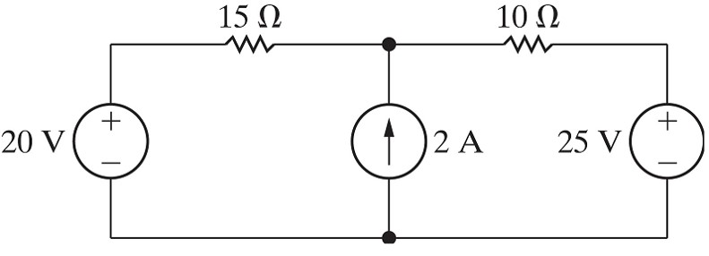




Chapter 4 – techniques of circuit analysis (3 of 14)
Node voltage method versus mesh current method
For the circuit below, find the power for the 2 A source:
Node voltage method:
  Number of essential nodes
  Number of single node K C L equations
  Number of supernode equations
  Number of supernode constraint equations
  Number of dependent source constraint equations
  Equations needed to find desired output

Slide 7



Chapter 4 – techniques of circuit analysis (4 of 14)
Node voltage method versus mesh current method
For the circuit below, find the power for the 2 A source:
Mesh current method:
  Number of meshes
  Number of single mesh K V L equations
  Number of supermesh equations
  Number of supermesh constraint equations
  Number of dependent source constraint equations
  Equations needed to find desired output

Slide 8
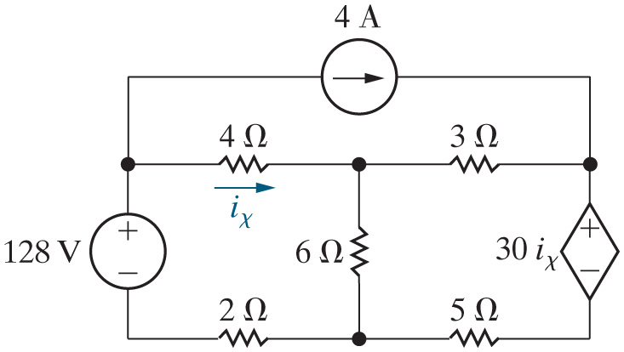



Chapter 4 – techniques of circuit analysis (5 of 14)
Node voltage method versus mesh current method
For the circuit below, find the power for the 4 A source:
Node voltage method:
  Number of essential nodes
  Number of single node K C L equations
  Number of supernode equations
  Number of supernode constraint equations
  Number of dependent source constraint equations
  Equations needed to find desired output

Slide 9



Chapter 4 – techniques of circuit analysis (6 of 14)
Node voltage method versus mesh current method
For the circuit below, find the power for the 4 A source:
Mesh current method:
  Number of meshes
  Number of single mesh K V L equations
  Number of supermesh equations
  Number of supermesh constraint equations
  Number of dependent source constraint equations
  Equations needed to find desired output

Slide 10
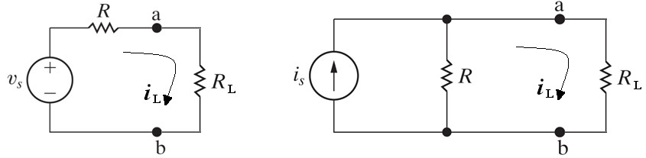
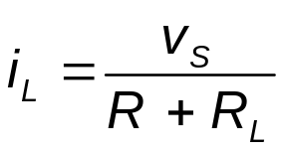
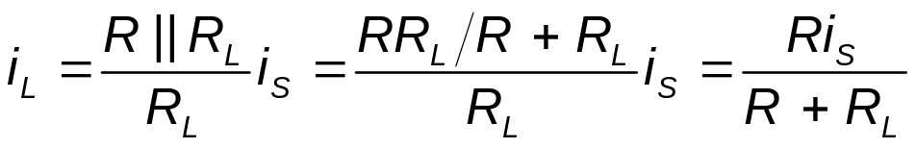

Chapter 4 – techniques of circuit analysis (7 of 14)
Source transformation
Under what condition(s) are the two circuits below “equivalent”? “Equivalent” means that if you attached any resistor to both circuits, it would have the same current, and therefore the same voltage and power.
- the condition for source transformation
Notes:
Long Description:
i subscript L Base Line equals Start Fraction R parallel to R subscript L Base Line over R subscript L Base Line End Fraction i subscript S Base Line equals Start Fraction R R subscript L Base Line divided by R plus R subscript L Base Line over R subscript L Base Line End Fraction i subscript S Base Line equals Start Fraction R i subscript S Base Line over R plus R subscript L Base Line End Fraction.

Slide 11

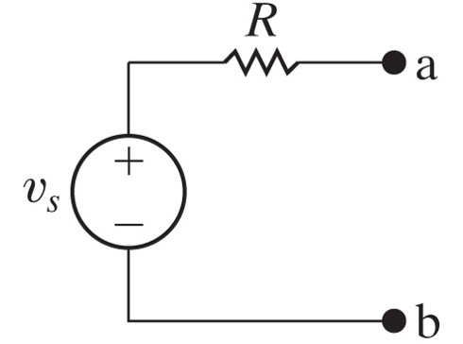
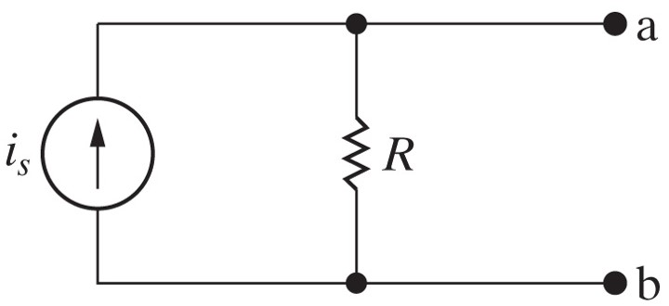

Chapter 4 – techniques of circuit analysis (8 of 14)
The condition for source transformation is
simply Ohm’s Law.

Slide 12
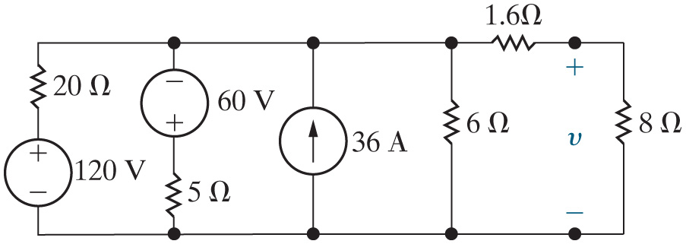
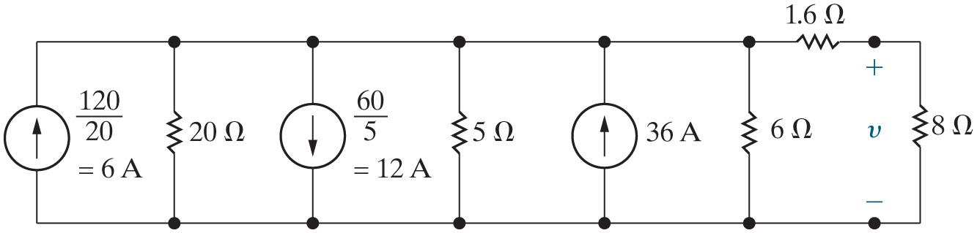
Chapter 4 – techniques of circuit analysis (9 of 14)
Source transformation
Find v in the circuit below by using a sequence of source transformations.
First step – source transform the two left-most branches in the circuit from series voltage source and resistor to parallel current source and resistor:

Slide 13
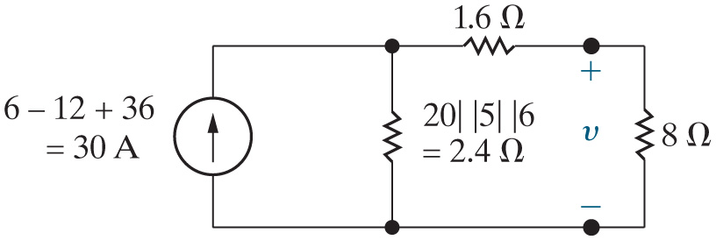
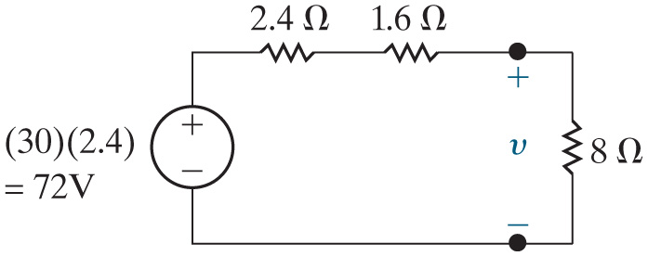
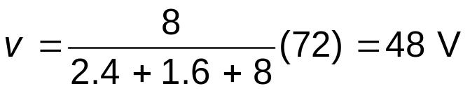
Chapter 4 – techniques of circuit analysis (10 of 14)
Second step – combine the three parallel-connected current sources into one current source, using K C L, and the three parallel-connected resistors into one resistor:
Third step – source transform the parallel current source and resistor to a series voltage source and resistor:
Fourth step – use voltage division to find v:

Slide 14

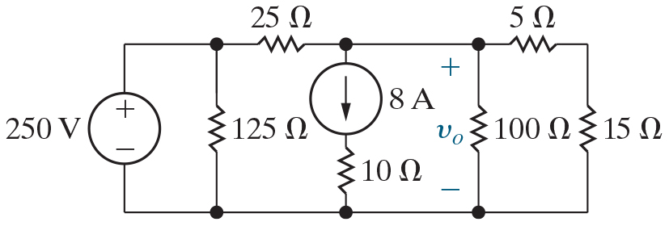
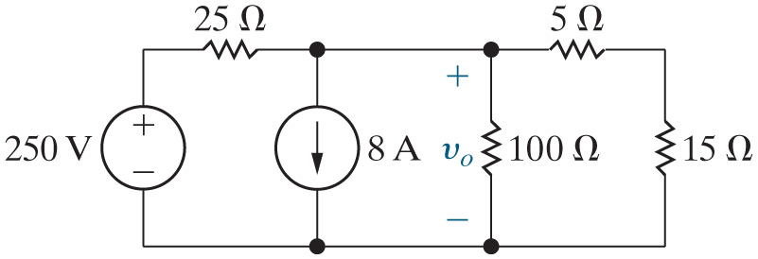
Chapter 4 – techniques of circuit analysis (12 of 14)
Source transformation
Find
and the source power in the circuit below by using a sequence
of source transformations.
First step – remove the resistor in parallel with the 250 V source, since it does not change the voltage drop between the top and bottom nodes on the left. Remove the resistor in series with the 8 A current source, since it does not change the current in that branch:

Slide 15


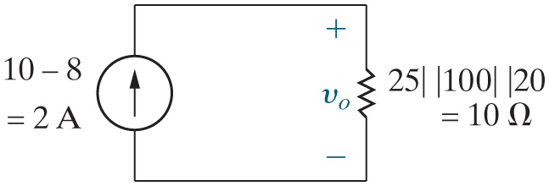
Chapter 4 – techniques of circuit analysis (13 of 14)
Second step – source transform the series-connected voltage source and resistor on the left, and combine the two series-connected resistors on the right into one equivalent resistor:
Third step – combine the two parallel current sources into one source, using K C L, and the three parallel resistors into one resistor:
Fourth step – use Ohm’s Law to find

Slide 16
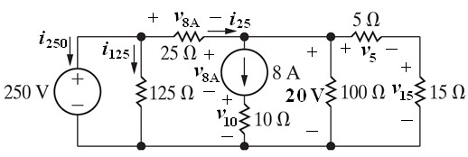
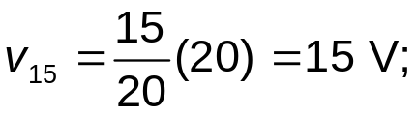















Chapter 4 – techniques of circuit analysis (14 of 14)
Fifth step – to balance the power, reinsert the resistors removed in Step 1:

Slide 17

Copyright
This work is protected by United Kingdom copyright laws and is provided solely for the use of instructors in teaching their courses and assessing student learning. Dissemination or sale of any part of this work (including on the World Wide Web) will destroy the integrity of the work and is not permitted. The work and materials from it should never be made available to students except by instructors using the accompanying text in their classes. All recipients of this work are expected to abide by these restrictions and to honor the intended pedagogical purposes and the needs of other instructors who rely on these materials.

